Slide 1

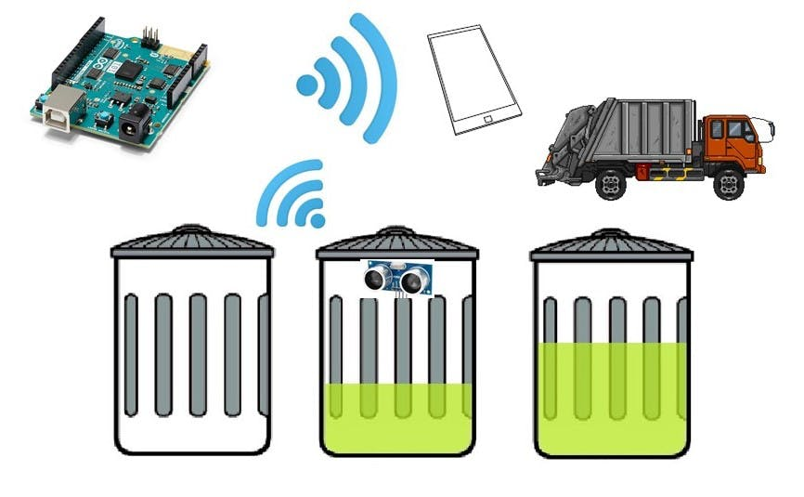
Smart IOT Garbage Monitoring System

Slide 2
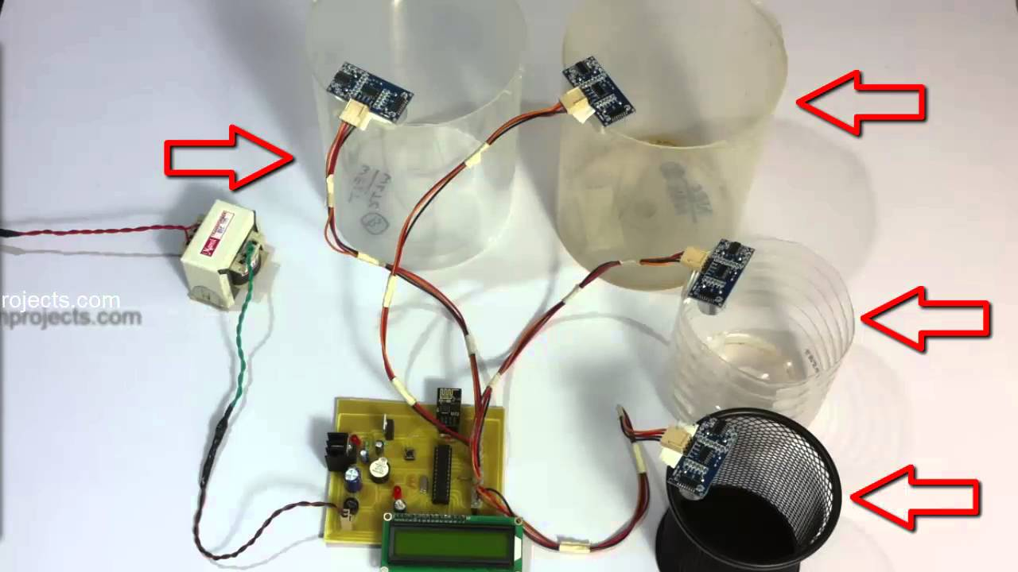
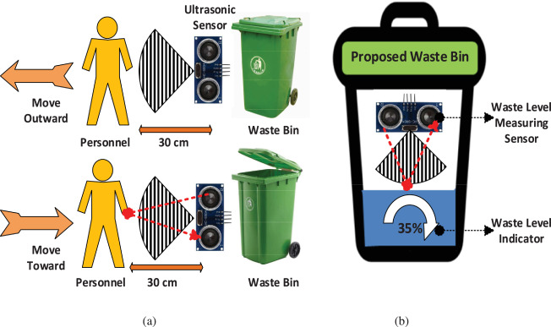
Why am I doing this ?
Now poper waste management is one of the major problem
The aim of the proposed method is to make use of this project is a very innovative system which will help to keep the cities clean.
What are the benefits of this?
Sensors are used to identify the people movement and the garbage level.
If person come infront of the garbage bin it will open automatically and monitors the
garbage bins and informs about the level of garbage collected in the garbage bins via a web
page
Main components
Arduino uno
LCD screen
Wifi modem for sending data
A buzzer
micro servo motor

Slide 3
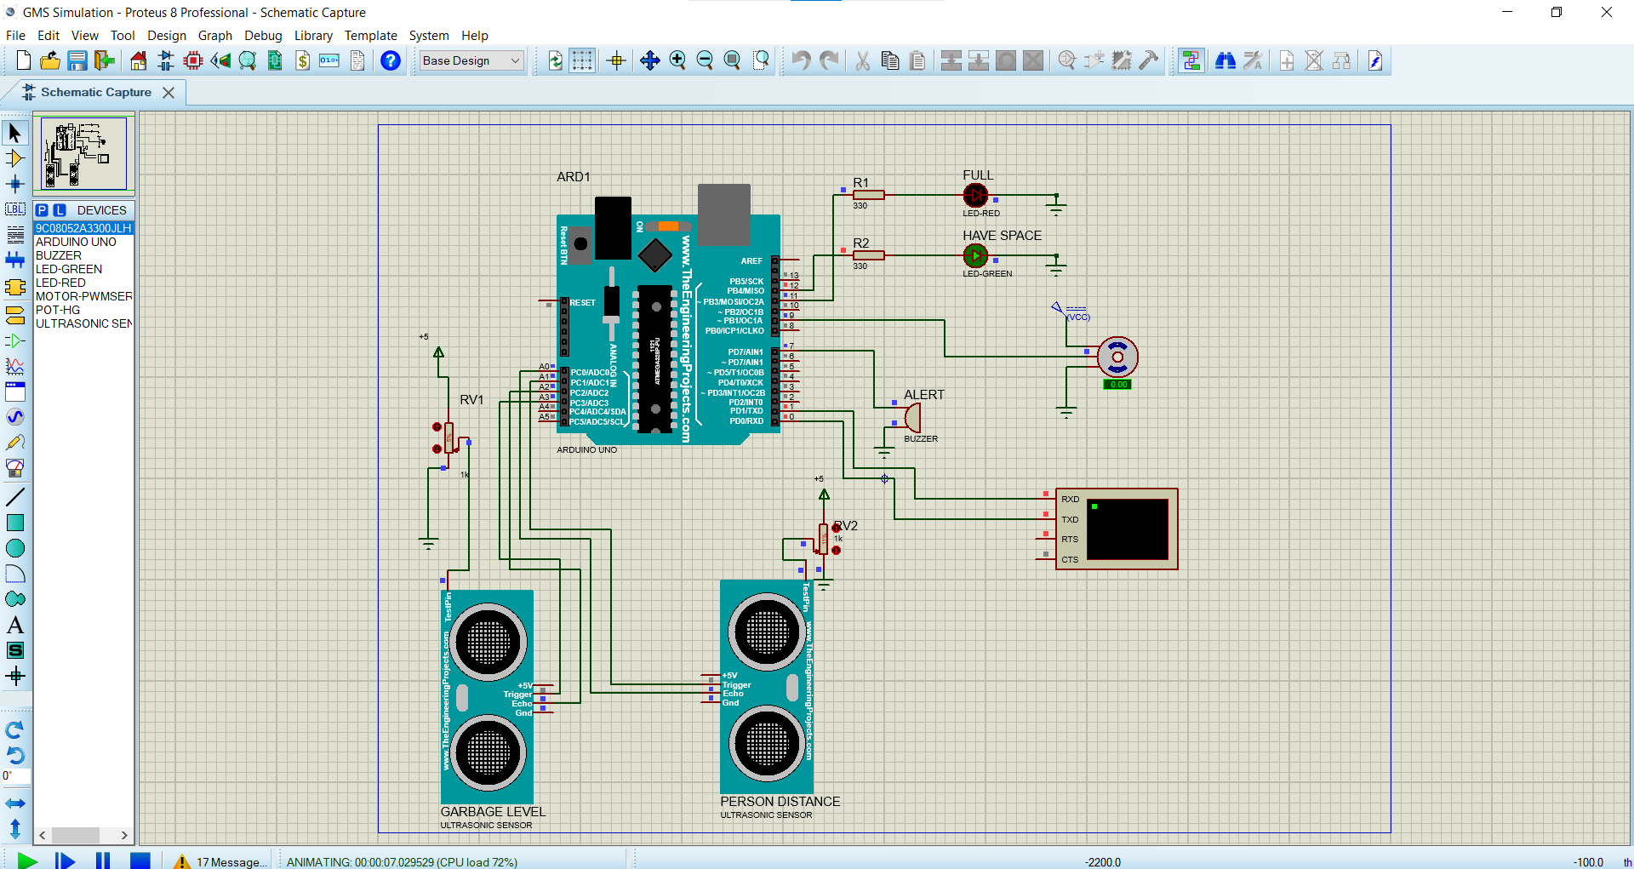
Proteus simulation

Slide 4
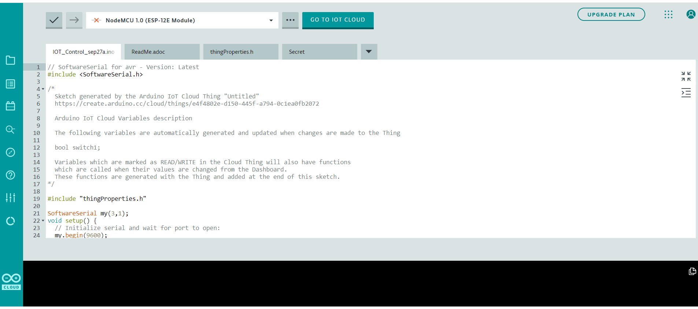
IOT Code

Slide 5
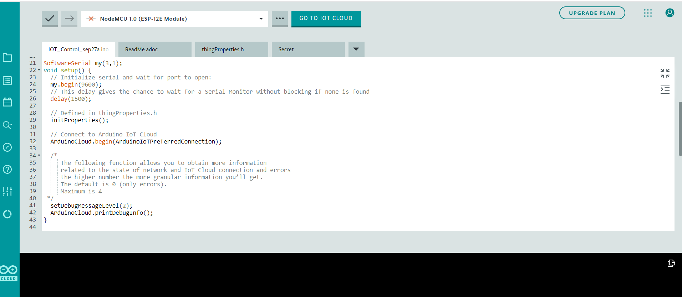

Slide 6
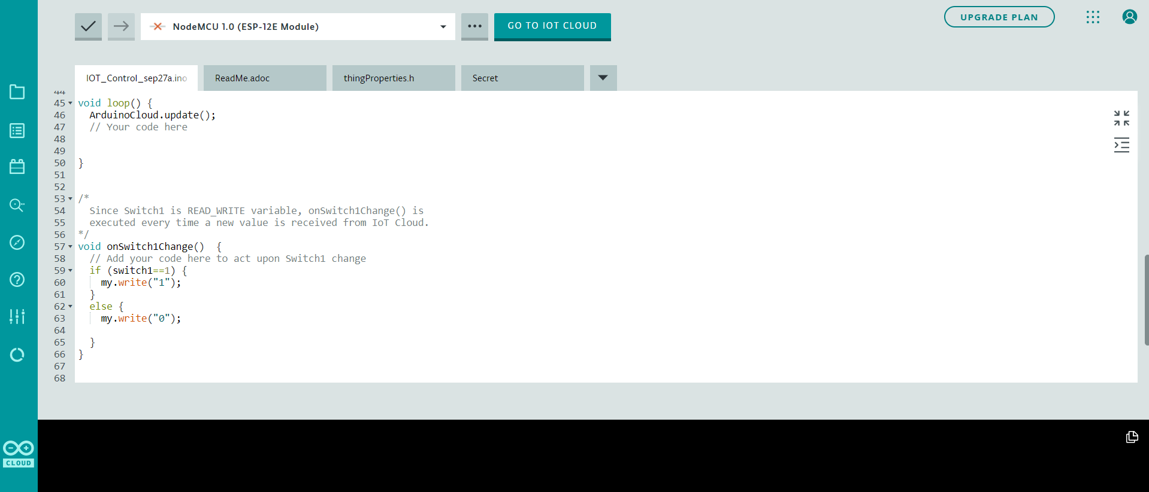

Slide 7
THANK YOU

